Slide 1
ARTIFICIAL INTELLIGENCE (AI)
Sudoku Solver
Rishi Gandhi BTech Data Science J022

Slide 2

PROBLEM STATEMENT
To create a Python program that can take an unsolved Sudoku puzzle as input and solve it, providing the completed Sudoku grid as output.

Slide 3
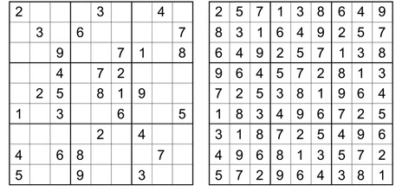
What is Sudoku Puzzle?
A Sudoku puzzle is a popular number puzzle or logic game that is typically played on a 9x9 grid.
The objective of Sudoku is to fill the grid with digits so that each column, each row, and each of the nine 3x3 sub grids (referred to as "regions" or "boxes") contains all of the digits from 1 to 9 without any repetition.

Slide 4
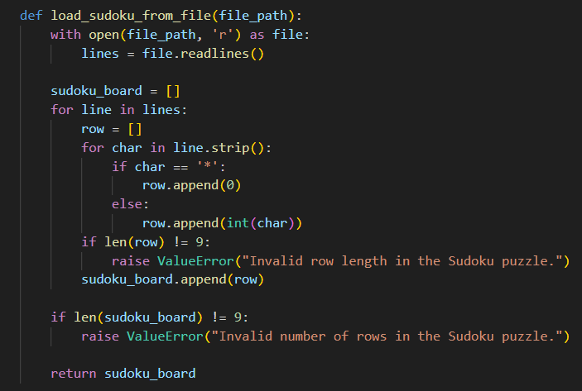
Reading Sudoku
This function reads a Sudoku puzzle from a text file specified by file_path.
It processes the file line by line, replacing asterisks (‘*') with zeros and converting digits to integers.
The resulting Sudoku board is a 2D list.
The function validates the format, ensuring there are exactly 9 rows, each containing 9 numbers or asterisks. If the format is invalid, it raises a ValueError.

Slide 5
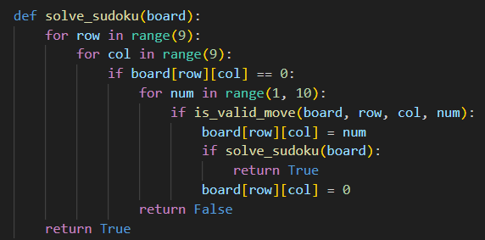
Sudoku Solver
This is the core function that recursively attempts to solve the Sudoku puzzle.
It uses a backtracking algorithm to fill in empty cells of the Sudoku board one by one.
The function iterates through each row and column and, if it finds an empty cell (represented by 0), it tries placing numbers from 1 to 9 and recursively calls itself to solve the puzzle.
If a solution is found, it returns True. If no valid number can be placed in the current cell, it backtracks by resetting the cell to 0 and returns False.

Slide 6
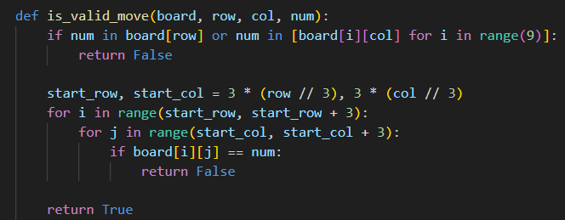
Valid move…?
This function checks if a given number (num) can be placed in a specific cell of the Sudoku board (board) without violating the rules of Sudoku.
It checks if num is not already present in the same row, column, or 3x3 subgrid.
If the move is valid, the function returns True; otherwise, it returns False.

Slide 7
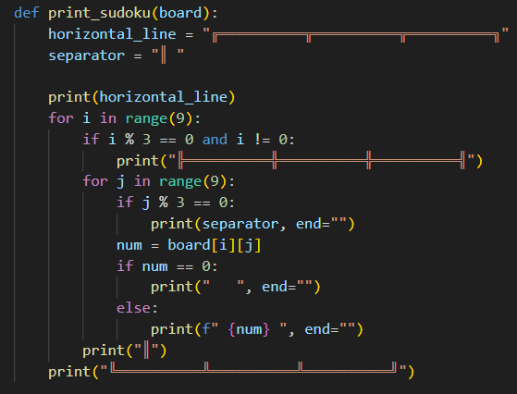
Printing the board
This function is responsible for printing the Sudoku board. It uses Unicode characters to create decorative borders for the grid.
horizontal_line is a string that represents the horizontal line used to separate rows of the Sudoku board.
separator represents the vertical separator used between cells.
The function iterates over the rows and columns of the Sudoku board and prints each cell, separating blocks and rows with horizontal and vertical lines as needed.

Slide 8
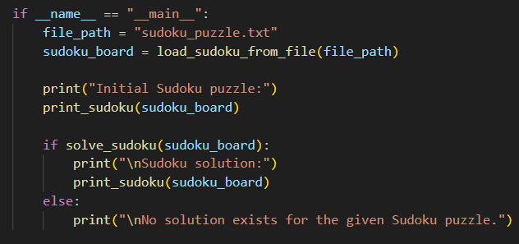
Main function
This part of the code runs when the script is executed as the main program.
It sets the file_path variable to the path of the Sudoku puzzle file.
It loads the Sudoku puzzle from the file using the load_sudoku_from_file function.
It prints the initial Sudoku puzzle using the print_sudoku function.
It attempts to solve the puzzle using the solve_sudoku function.
If a solution is found, it prints the Sudoku solution using the print_sudoku function. If no solution exists, it prints a message indicating that.

Slide 9
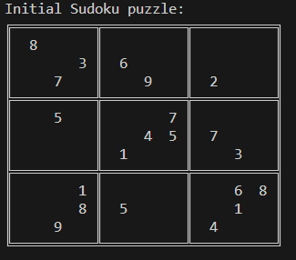
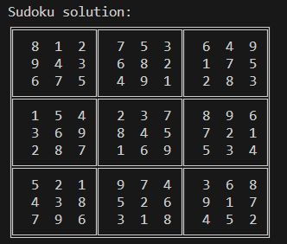
Output

Slide 10
Thank You

